Slide 1


Slide 2


Slide 3
Duration: 20 minutes Minimum Word Limit: 150 Words
Introduction (1-2 sentences) | Paraphrase the question.
Overview (2-3 sentences) | Study the entire data and try to understand the main point of the information. Don’t mention details.
Body (1-3 paragraphs/ 5-7 sentences) | Describe the data. Use paragraphs (if needed) to sort information by time, type or action.

Slide 4
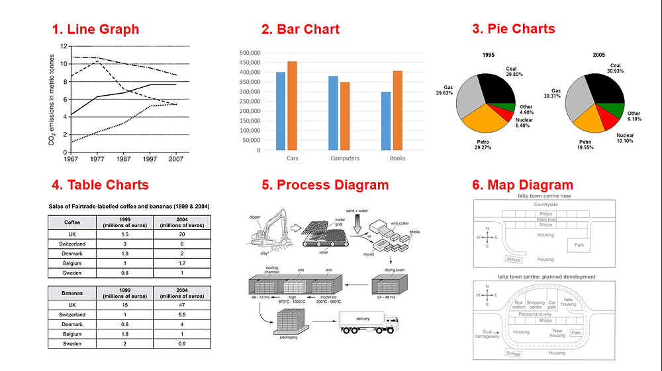

Slide 5
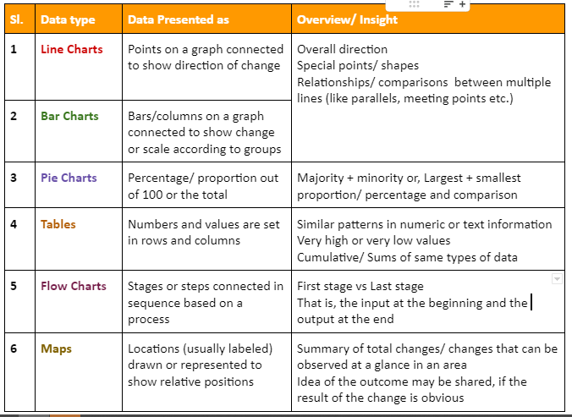

Slide 6
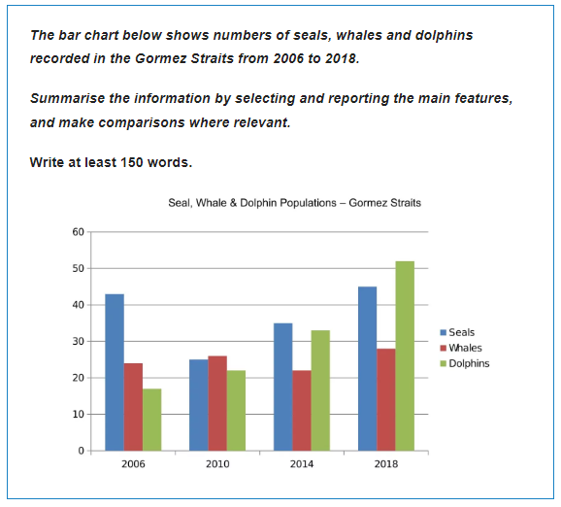
Bar Chart

Slide 7
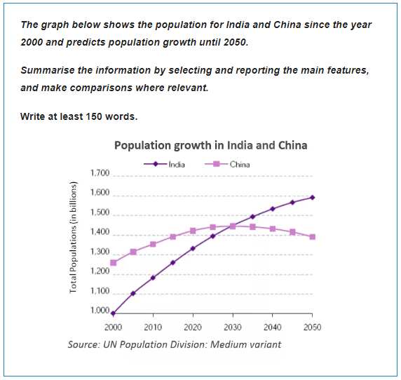
Line Graph

Slide 8
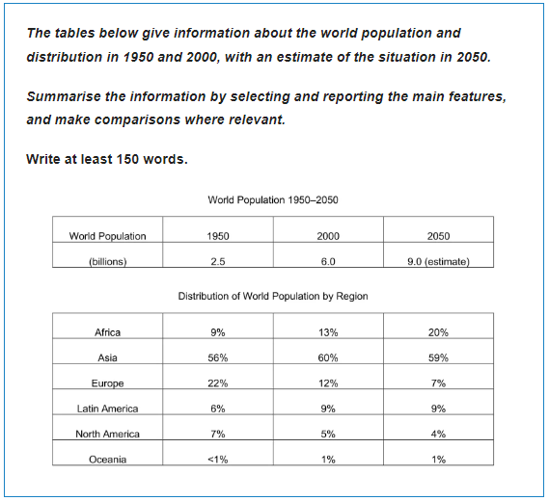
Table

Slide 9
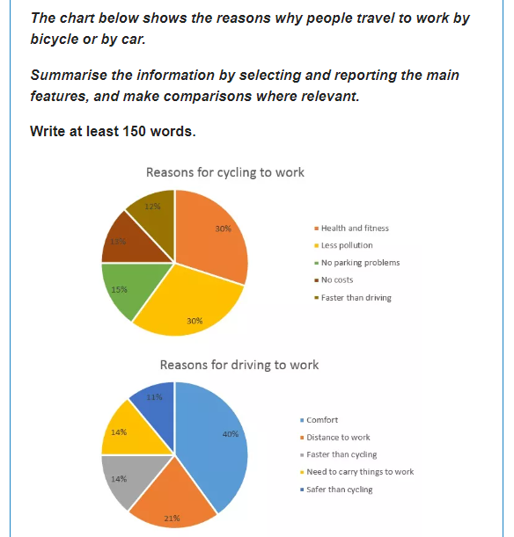
Pie Chart

Slide 10
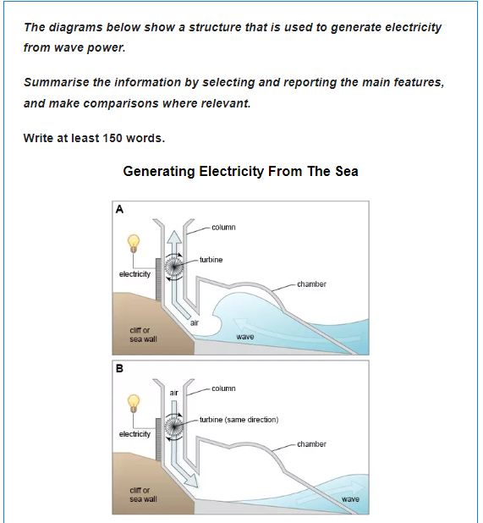
Process
Diagram

Slide 11
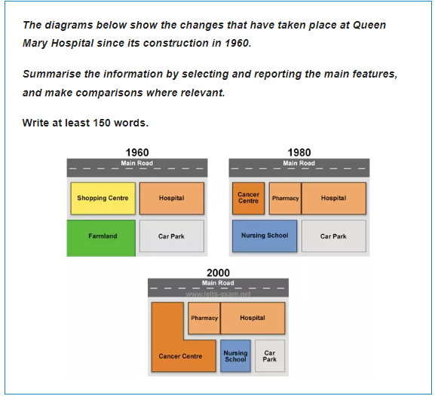
Map

Slide 12
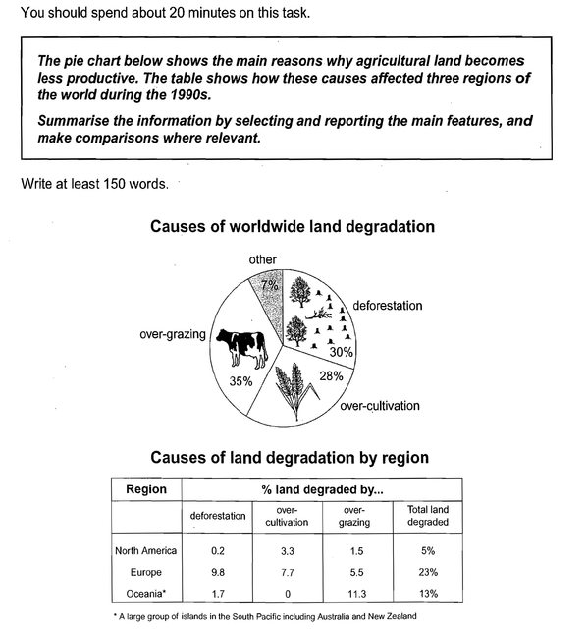
Multiple
Graphs

